Slide 1
Hamster Capstone 100% Status Update
By: Jared Hemauer, Rylee Horney, Keenan Keams, Joseph Lopez

Slide 2
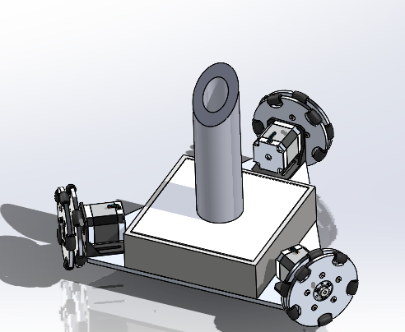
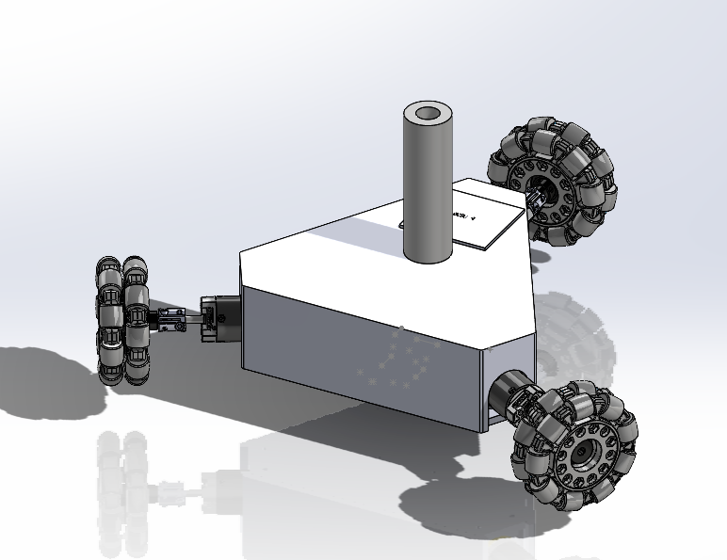
2nd & 3rd Iteration of Hamster

Slide 3
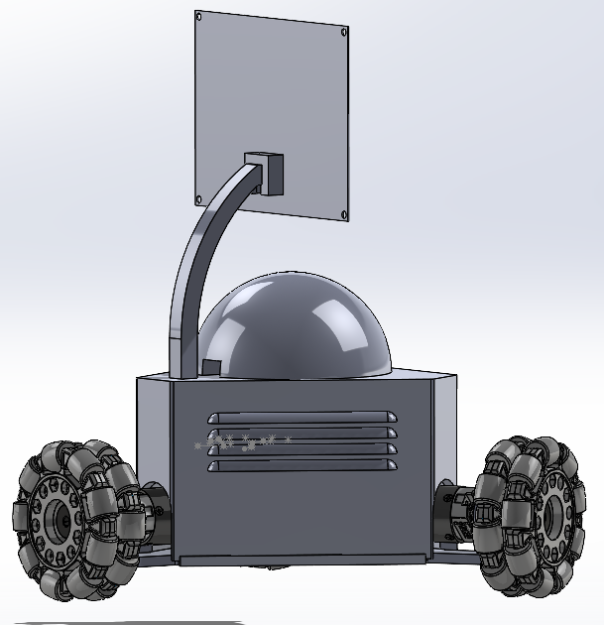
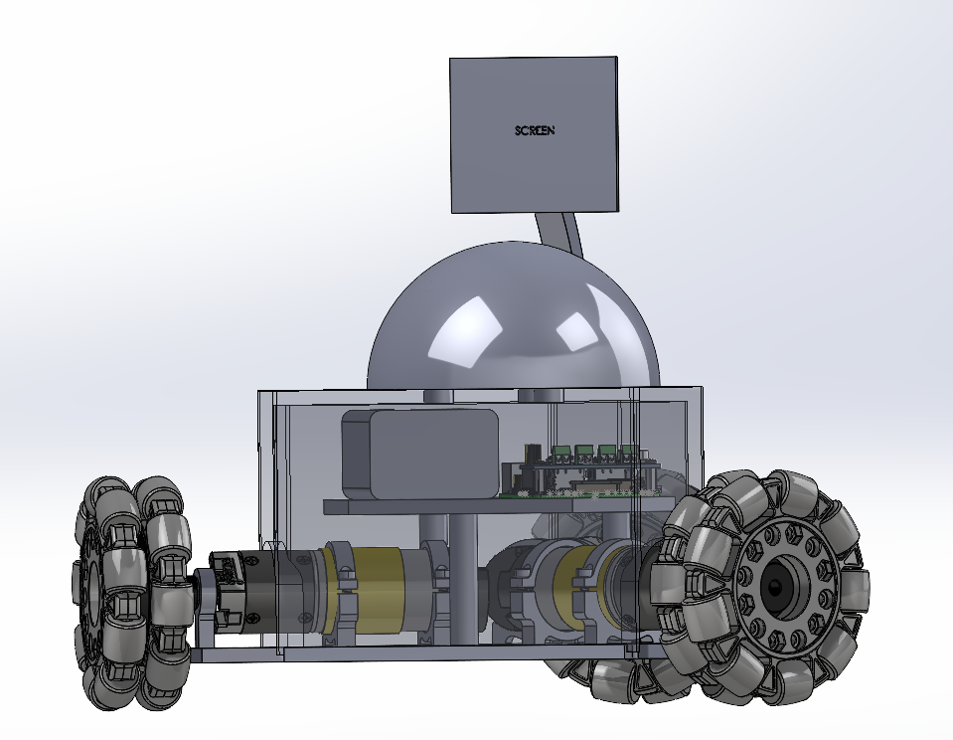
4th & 5th Iteration of Hamster

Slide 4
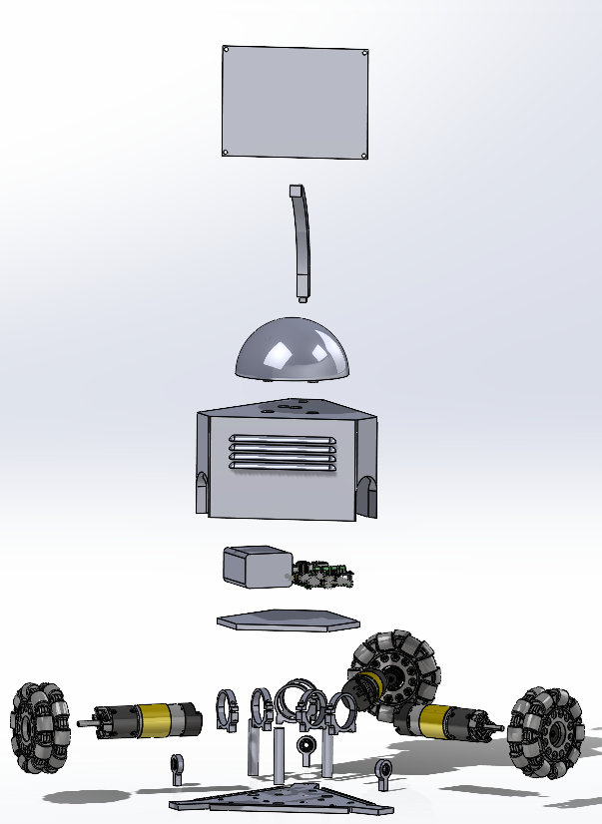
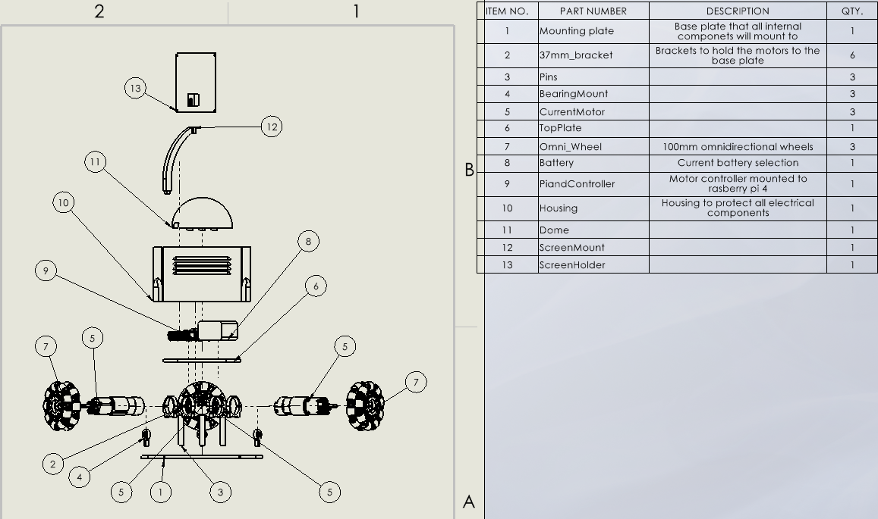
Exploded View

Slide 5
BOM and Manufacturing Update

Slide 6
Gantt Chart Update

Slide 7
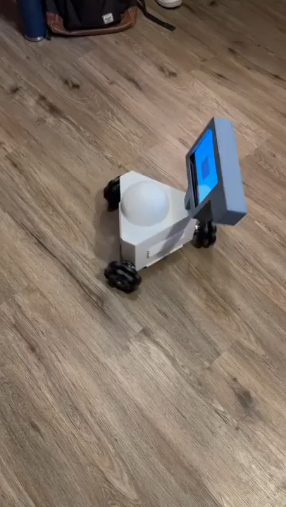
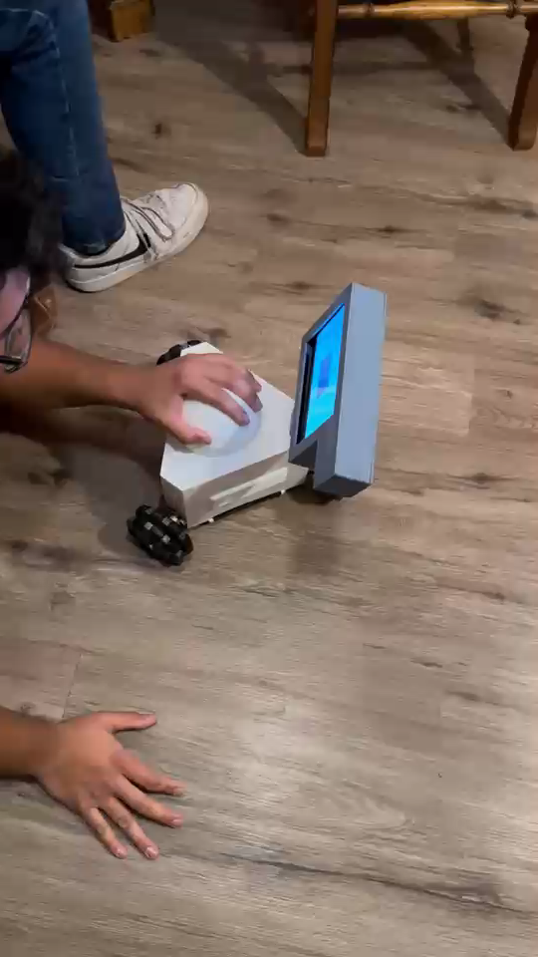
Demonstration

Slide 8
Thank you

